Slide 1
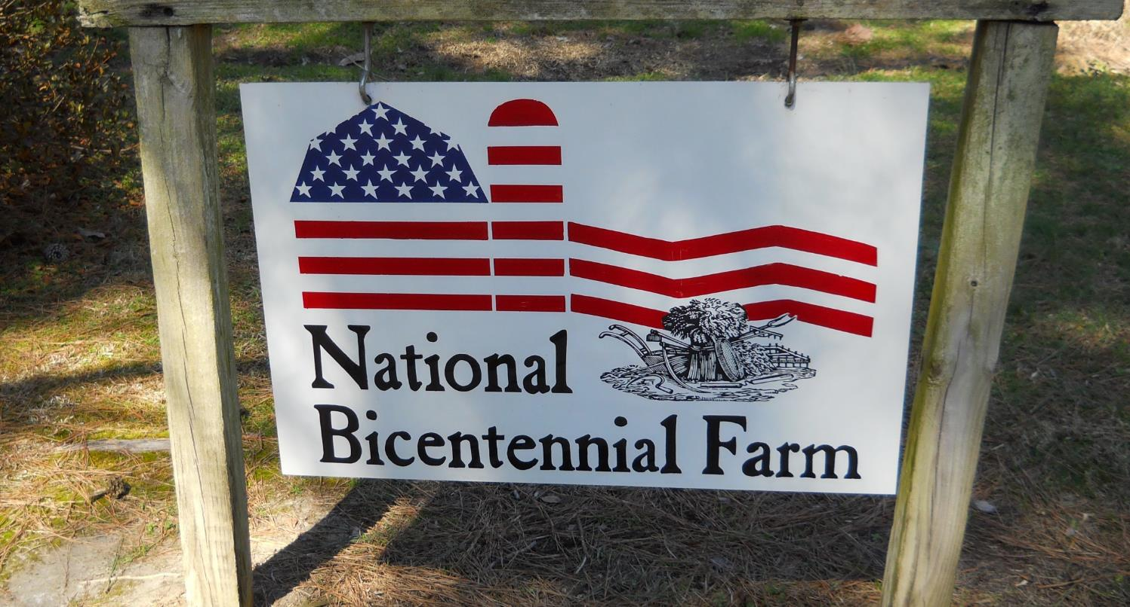
Weed Management Update

Slide 2
Agenda
1. What’s new
2. What’s gone
3. Cool stuff!!!

Slide 3
New Labels
Select Max -- okra
Select Max – green onions

Slide 4
Expected Labels --- Soon
Reflex -- sweet potato
Reflex – eggplant

Slide 5
What did we lose?
Paladin Fumigant

Slide 6
2020 Fumigant Systems For Weeds
  Paladin Pic + Metam TIF
  T2/Pic/Metam* TIF
All common weeds
Good nutsedge, watch grass and pigweed
  3. Paladin Pic TIF
  4. T2/Pic/Metam LDPE
Watch nutsedge, good grass and pigweed
Watch nutsedge, grass, and pigweed… ...nematodes??
  5. Pic Chlor 60 TIF
*UGA 3-WAY: system of Telone II, Pic, Metam

Slide 7
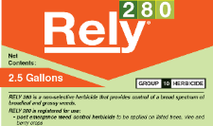

Cool Research
No Label Currently; Hopefully BASF Wont Back Out On Us

Slide 8
Cool Research
No Label Currently; Hopefully BASF Wont Back Out On Us
Row middles in plastic production
Prepare to plant in bareground
Prepare to plant in mulch

Slide 9
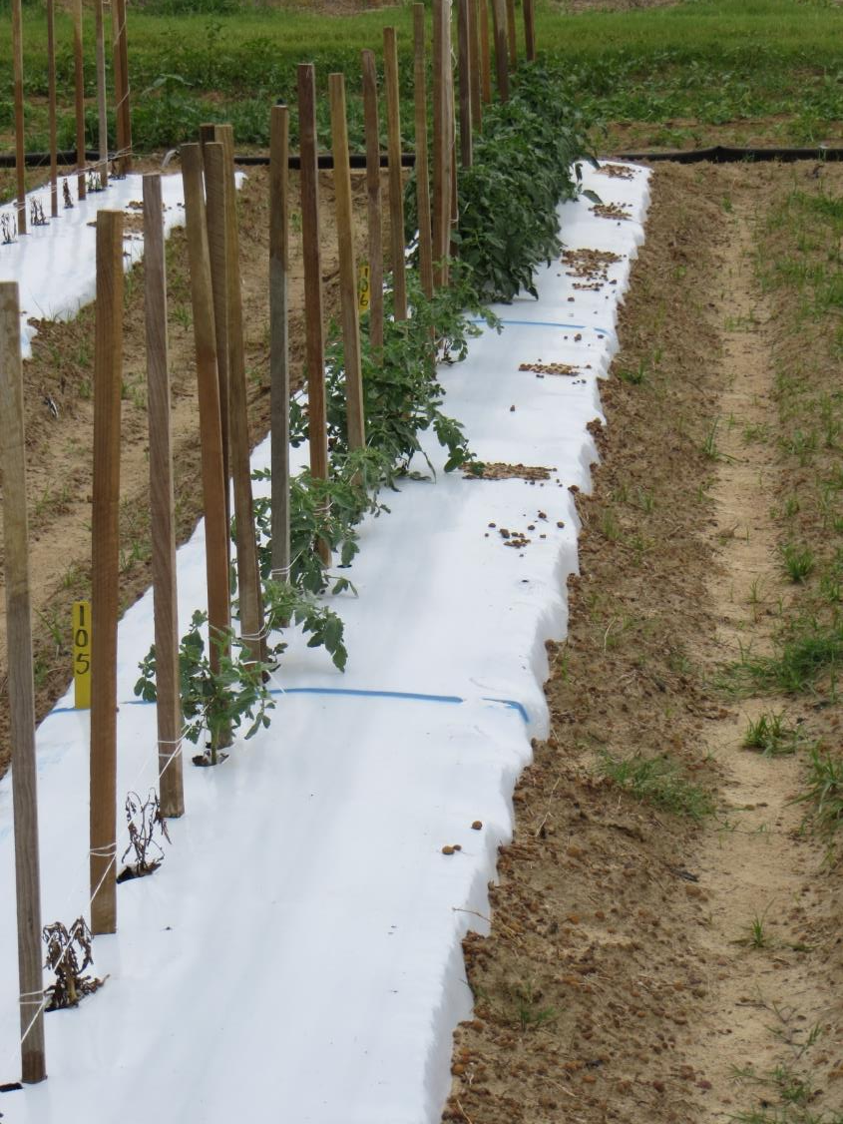
Row - Middle
Rely Row Middle
Rely Directed ¼ X rate
Liberty Directed
Rely Topical

Slide 10
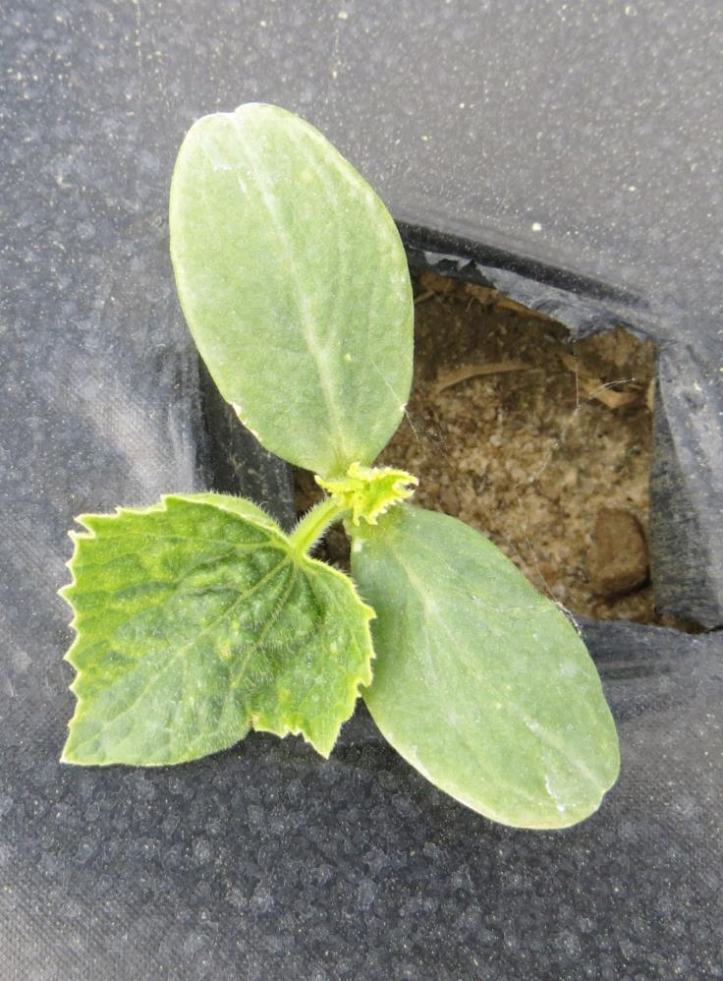
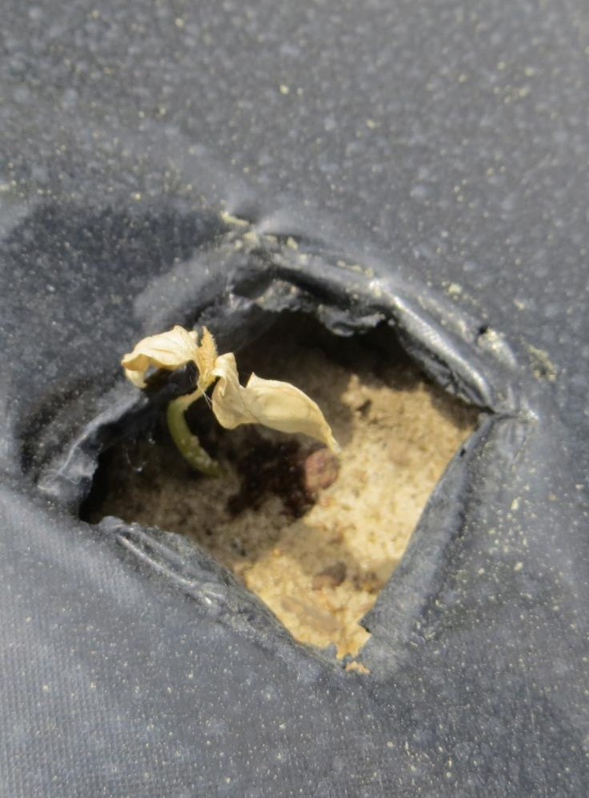
Rely Applied Over Mulch
washed
NOT washed

Slide 11
Bareground – preplant
Huge Concern for Transplants

Slide 12
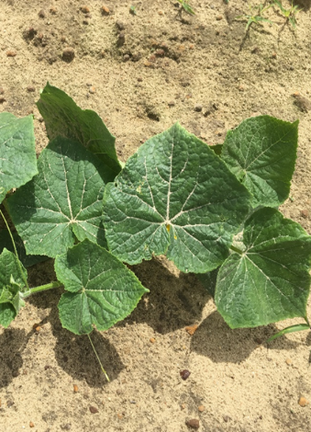
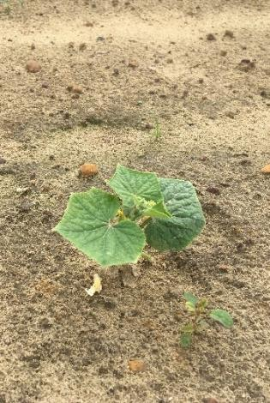
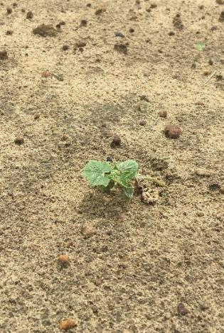
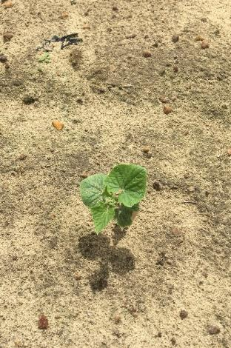
Transplant Cucumber Response to Rely
None
7 DBP
4 DBP
1 DBP
48 oz/A
Rely
Injury 20 DAP. Tifton, GA. 2018. DBP = days before planting.
POSTER

Slide 13


Cool Research
No residual activity so plant what and when you want?
Comes off plastic easy!

Slide 14
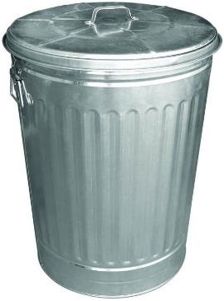
Cool Research
No residual activity so plant what and when you want?
Comes off plastic easy!

Slide 15
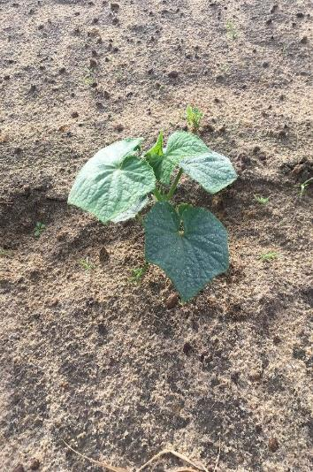
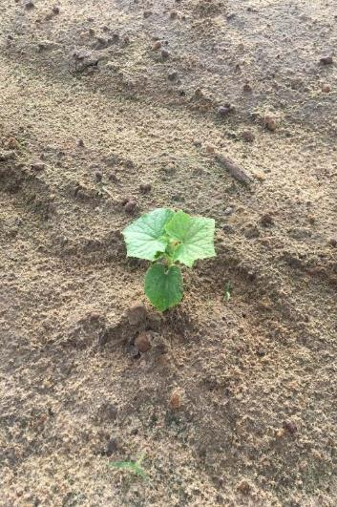
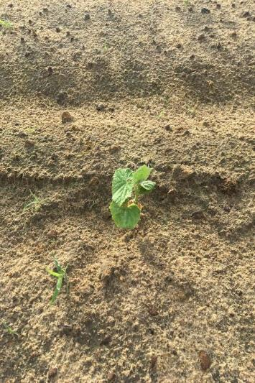
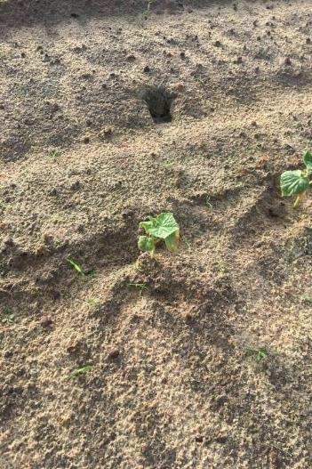
Transplant Cucumber Response to PowerMax
None
7 DBP
4 DBP
1 DBP
64 oz/A
PowerMax
Injury 14 DAT; Tifton. GA 2018. DBP = days before planting.

Slide 16
Vegetable Transplant Injury From PowerMax at 64 oz/A Applied Preplant Bareground.
69
%
53
55
51
48
43
41
Eggplant
Pepper
Squash
Tomato
Cantaloupe
Cucumber
Watermelon
Injury 21 DAP. Tifton, GA. 2019. Herbicide applied 3 d before transplant.

Slide 17
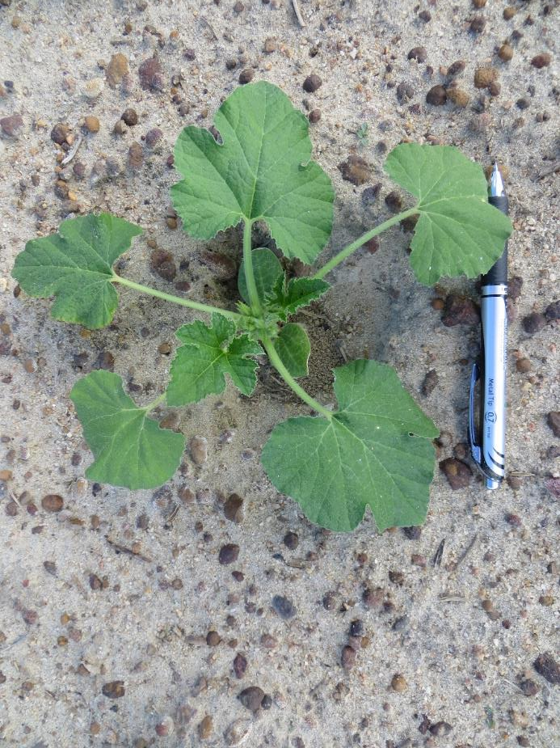
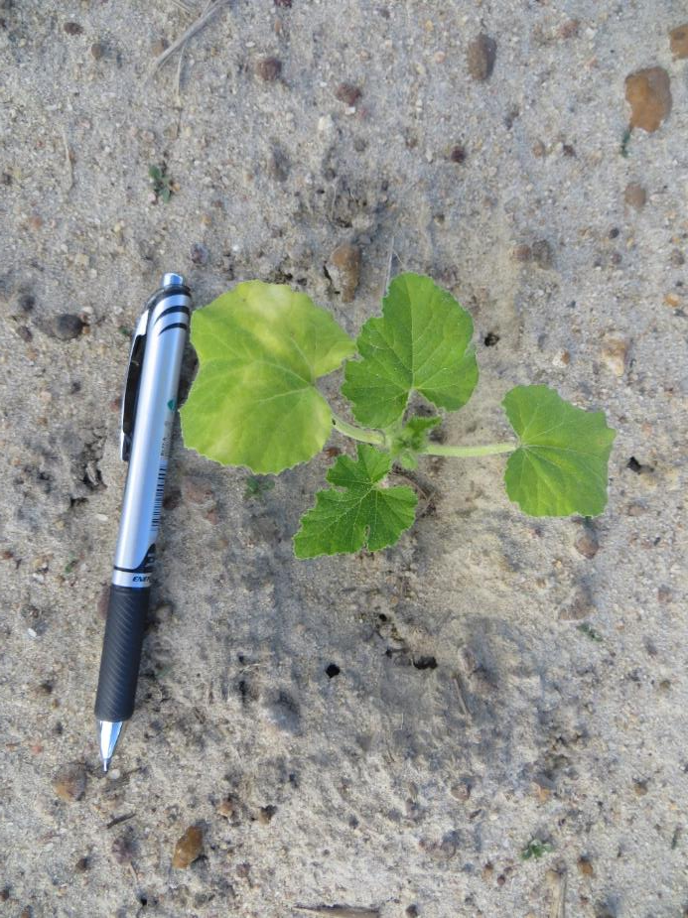
Yellow squash response to 64 oz/A of PowerMax II Preplant
Non-treated

Slide 18
Roundup Over Mulch Prior to Transplant
We know you have to wash off with 0.5” in single event
What happens when the Roundup ends up in an old hole

Slide 19
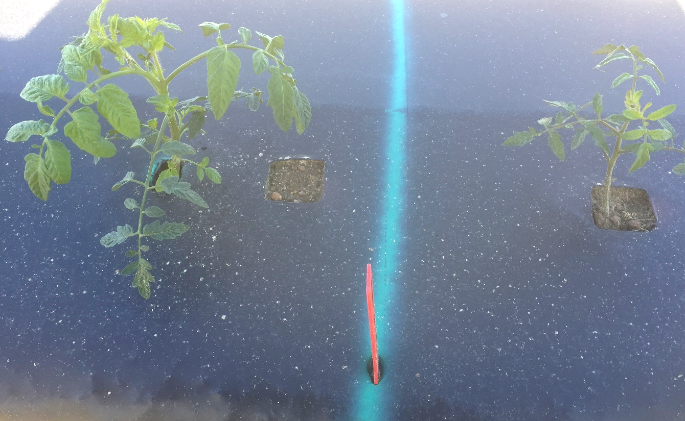
Roundup PMAX 64 oz/A Applied Over Mulch Followed by 0.5” Irrigation Before Transplant
Old hole present when spray
New hole after spray/irrigation

Slide 20
Influencing Injury Potential
Soil – sand, organic matter
Rate
Tillage
Irrigation

Slide 21
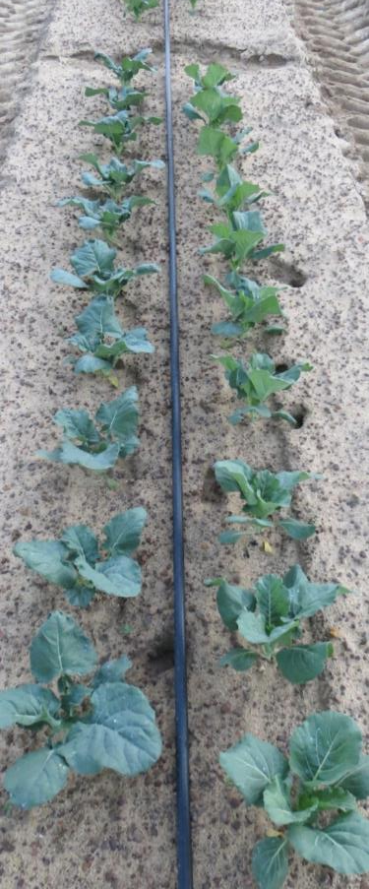
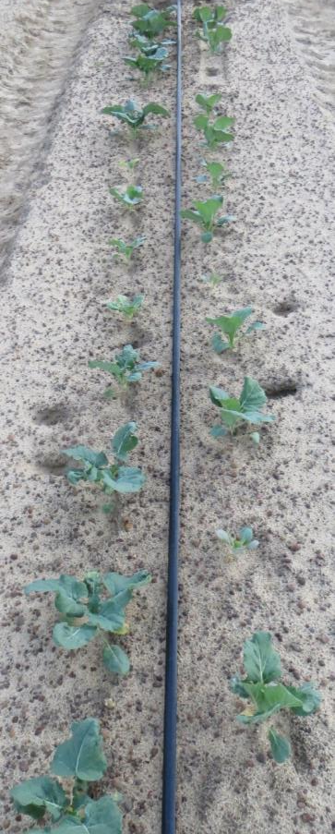
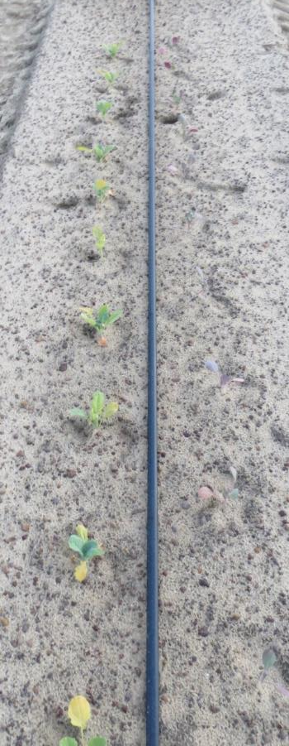
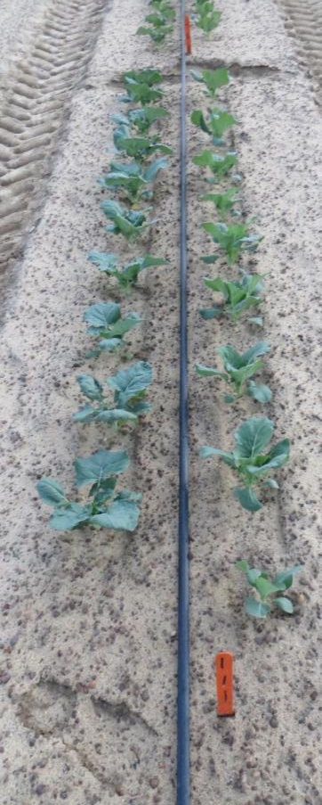
Cole crop response to Roundup preplant
Non-treated
RU PMAX
+ Irrigation
+ tillage

Slide 22
Influencing Injury Potential
Soil – sand, organic matter
Rate
Tillage
Irrigation
Transplanting method

Slide 23
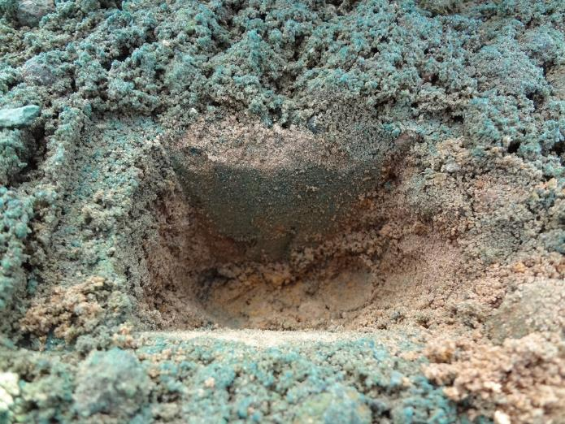
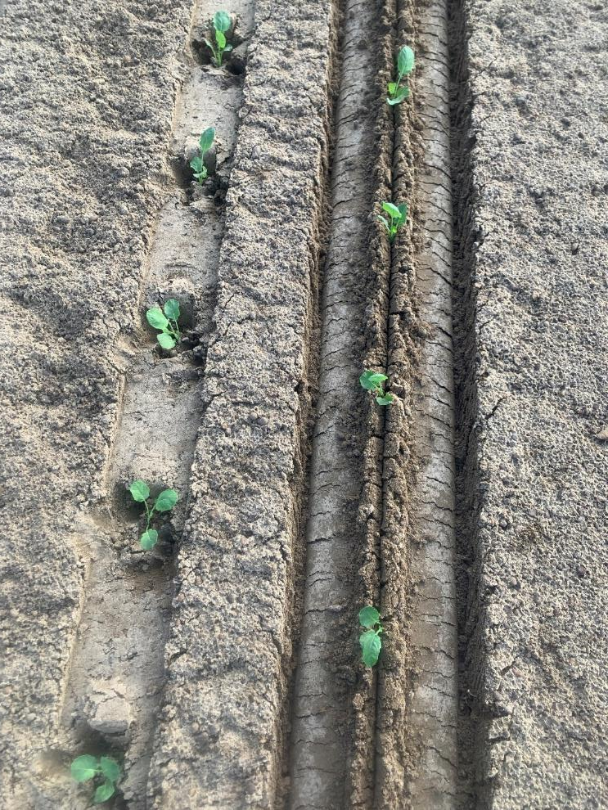
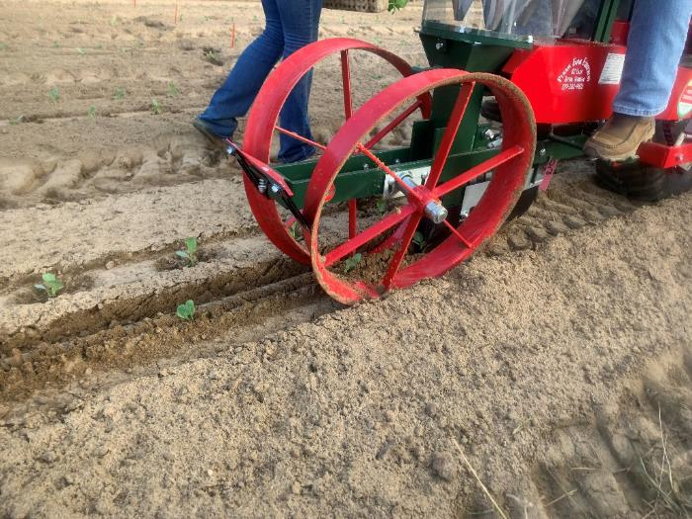

Slide 24
Example of Planter Type Influencing Vegetable Herbicide Injury
%
Transplanter
Herbicide Rate Increasing

Slide 25
Example of Planter Type Influencing Weed Control
%
Transplanter
Herbicide Rate Increasing

Slide 26
New RU PMAX II Label – Transplants
Soil >85% sand and/or < 0.5% O.M.
Bareground:
< 32 oz/A > 3 days 0.5” water
Mulch:
<32 oz/A > 3 days 0.5” water
32 to 64 oz/A >10 days 0.5” water

Slide 27
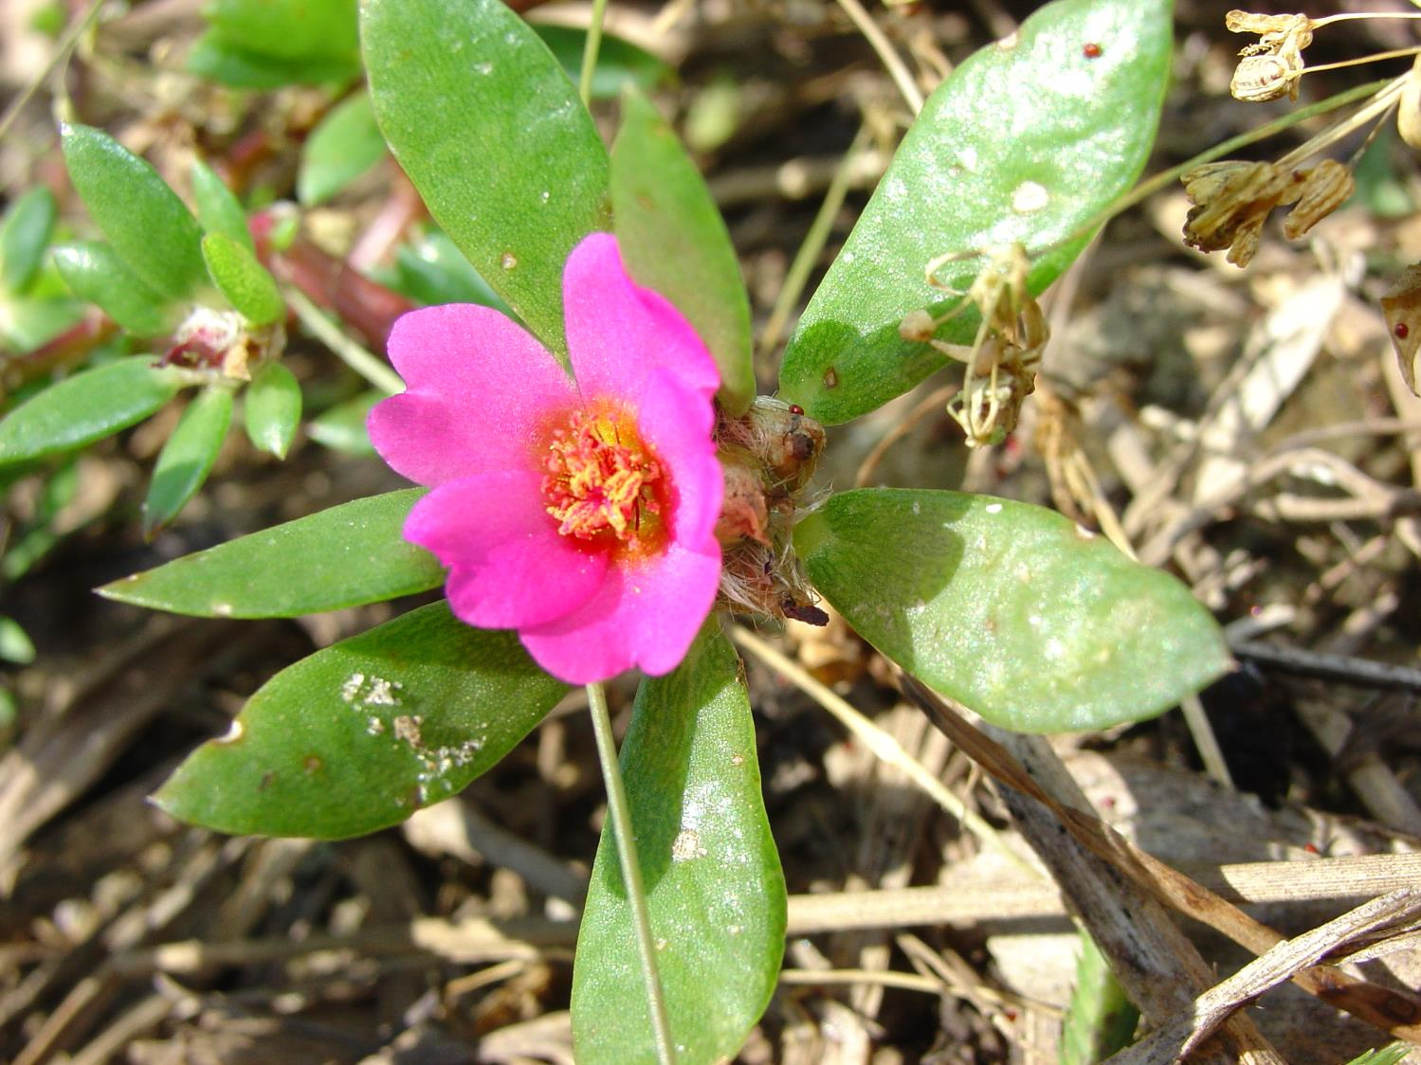
1. Residual herbicides are key in crop.
2. Between Crops: Max Roundup allowable followed by Gramoxone 5 to 7 d later.

Slide 28


Cool Research
Not Even Remotely Close to Being Labeled but……………
Can 2,4-D and dicamba be washed from mulch?

Slide 30
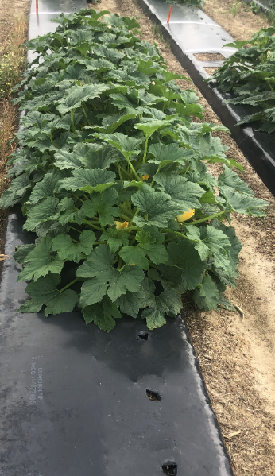
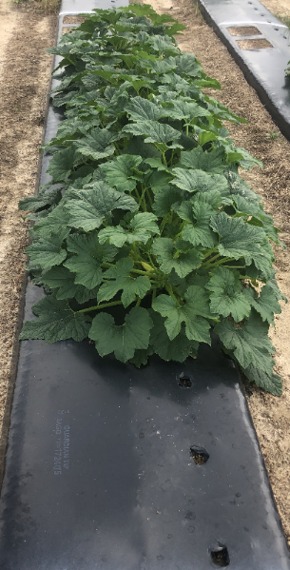
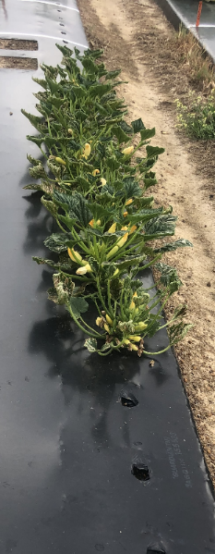
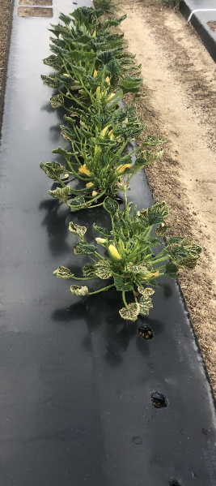
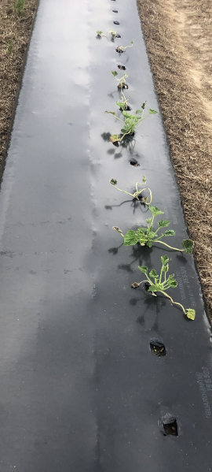
Squash Response to Dicamba
No
Dicamba
45 DBP
30 DBP
15 DBP
1 DBP
> 1.4 inch of rain for 15 or more days

Slide 31

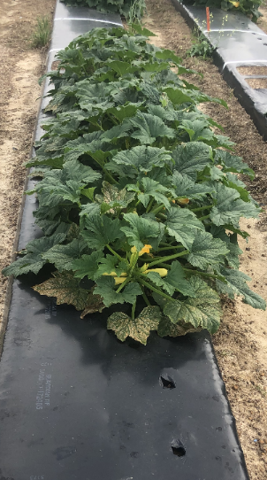
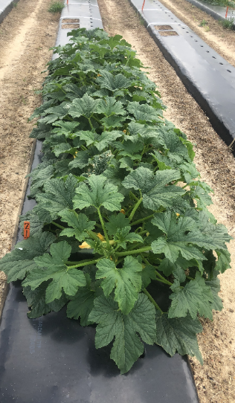
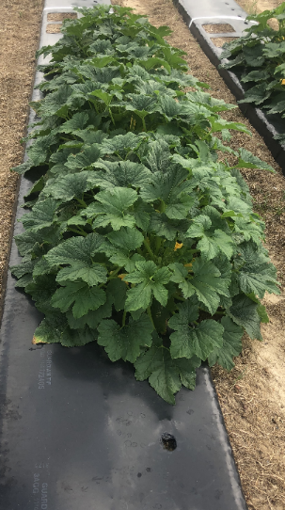
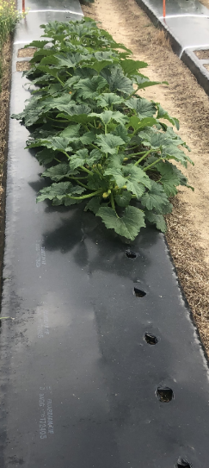
Squash Response to 2,4-D
NTC
45 DBP
30 DBP
15 DBP
1 DBP
2,4-D
> 1.4 inch of rain for 15 or more days

Slide 32
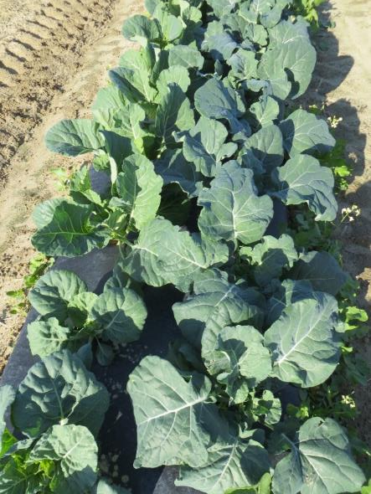
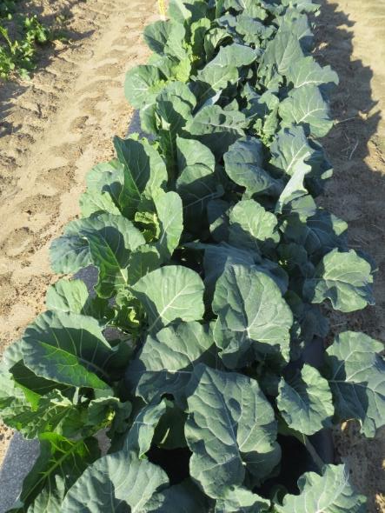
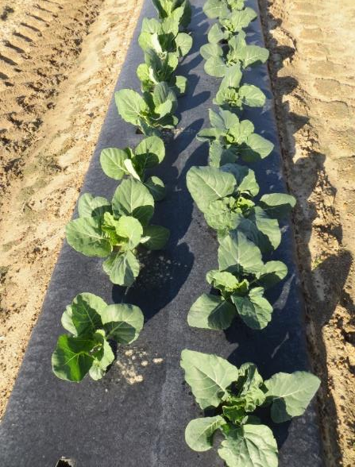
Broccoli/Collard Response to 2,4-D Preplant
2,4-D
No holes
washed
2,4-D
Holes
washed
No Herbicide

Slide 33




Cooperation And Education
Georgia Farmers
Consultants
Industry Partners

Slide 34
Cooperation And Education
Georgia Farmers
Support by the Vegetable Commodity Commission Makes These
Efforts Possible
Consultants
Industry Partners

